Slide 1
Module 7: Authentication, Authorization, and Accounting (AAA)
Instructor Materials
Networking Security v1.0
(NETSEC)
Notes:
Networking Security (NETSEC) Module 7: Authentication, Authorization, and Accounting (AAA)

Slide 2
Module Objectives
Module Title: Authentication, Authorization, and Accounting (AAA)
Module Objective: Configure AAA to secure a network.
Topic Title | Topic Objective
AAA Characteristics | Describe AAA.
Configure Local AAA Authentication | Configure AAA authentication to validate users against a local database.
Server-Based AAA Characteristics and Protocols | Describe the server-based AAA protocols.
Configure Server-Based Authentication | Configure server-based AAA authentication on Cisco routers.
Configure Server-Based Authorization and Accounting | Use the correct command to configure server-based AAA authorization and Accounting
Notes:
2

Slide 3
7.1 AAA Characteristics
Notes:
7: Authentication, Authorization, and Accounting (AAA) 7.1: AAA Characteristics

Slide 4
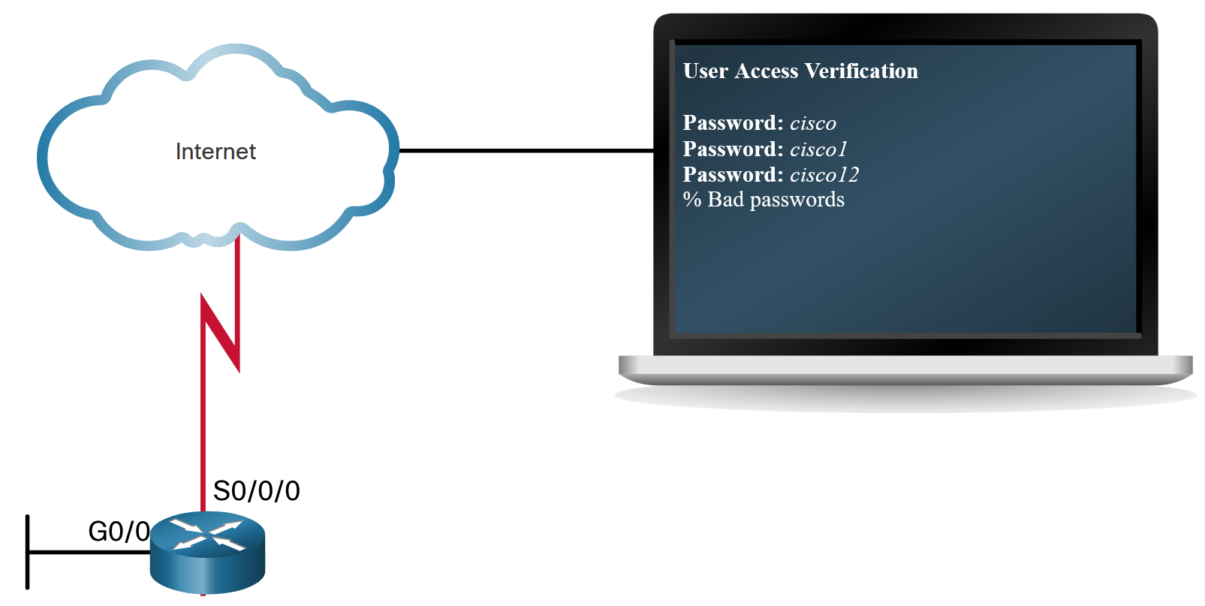
AAA Characteristics
Authentication without AAA
The simplest method of remote access authentication is to configure a login and password combination on console, vty lines, and aux ports, as shown in the figure.
This method provides no accountability. Anyone with the password can gain entry to the device and alter the configuration.
SSH is a more secure form of remote access. It requires both a username and a password, both of which are encrypted during transmissions. The local database method has some limitations. The user accounts must be configured locally on each device.
Notes:
7: Authentication, Authorization, and Accounting (AAA) 7.1: AAA Characteristics 7.1.1: Authentication without AAA

Slide 5
AAA Characteristics
AAA Components
Network and administrative AAA security in the Cisco environment has three functional components:
Authentication - Users and administrators must prove their identity before accessing the network and network resources. Authentication can be established using username and password combinations, challenge and response questions, token cards, and other methods. For example: “I am user ‘student’ and I know the password to prove it.”
Authorization - After the user is authenticated, authorization services determine which resources the user can access and which operations the user is allowed to perform. An example is “User ‘student’ can access host serverXYZ using SSH only.”
Accounting and auditing - Accounting records what the user does, including what is accessed, the amount of time the resource is accessed, and any changes that were made. Accounting keeps track of how network resources are used. An example is "User 'student' accessed host serverXYZ using SSH for 15 minutes."
Notes:
7: Authentication, Authorization, and Accounting (AAA) 7.1: AAA Characteristics 7.1.2: AAA Components

Slide 6
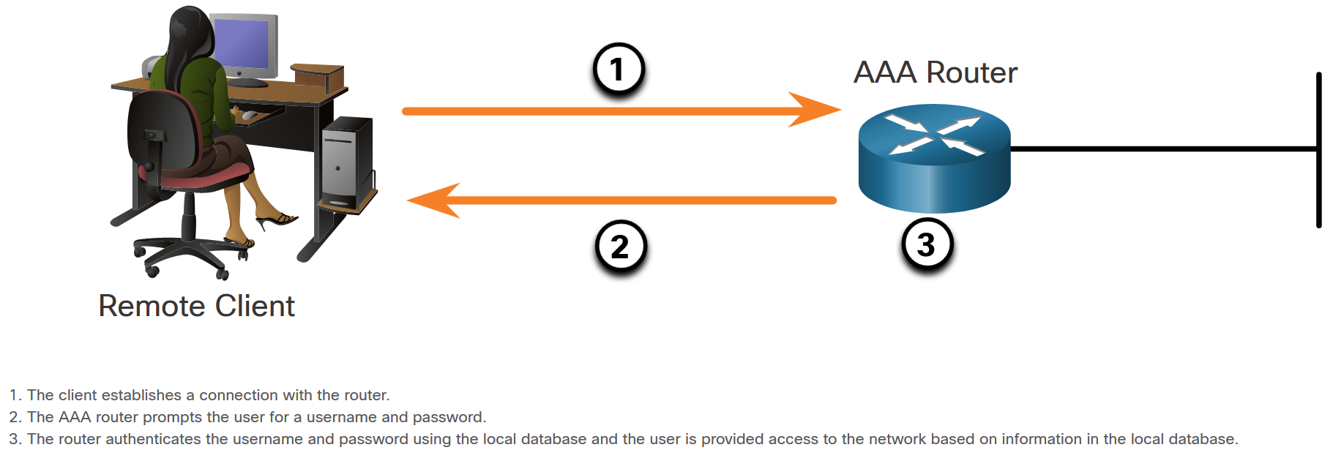
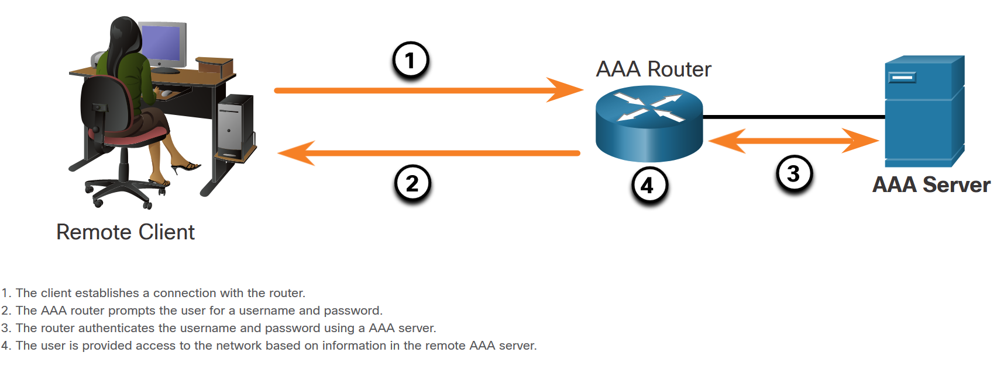
AAA Characteristics
Authentication Modes
Cisco provides two common methods of implementing AAA services:
Local AAA Authentication -Local AAA uses a local database for authentication. This method is sometimes known as self-contained authentication. In this course, it will be referred to as local AAA authentication.
Server-Based AAA Authentication - With the server-based method, the router accesses a central AAA server, such as the Cisco Secure Access Control System (ACS) for Windows, which is shown in the figure. The central AAA server contains the usernames and password for all users. The router uses either the Remote Authentication Dial-In User Service (RADIUS) or Terminal Access Controller Access Control System (TACACS+) protocols to communicate with the AAA server.
Notes:
7: Authentication, Authorization, and Accounting (AAA) 7.1: AAA Characteristics 7.1.3: Authentication Modes

Slide 7
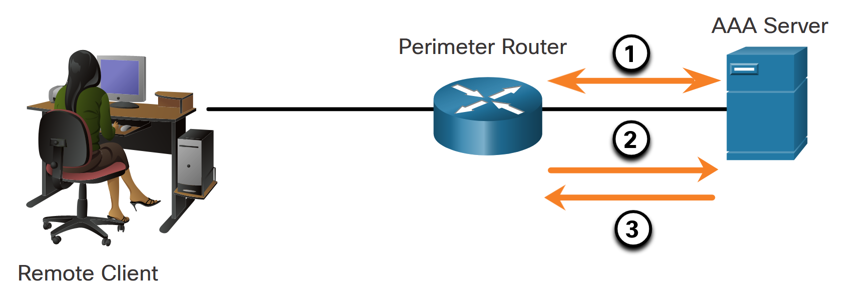
AAA Characteristics
Authorization
After users are successfully authenticated against the selected AAA data source, either local or server-based, they are then authorized for specific network resources, as shown in the figure.
Notes:
7: Authentication, Authorization, and Accounting (AAA) 7.1: AAA Characteristics 7.1.4: Authorization

Slide 8
AAA Characteristics
Accounting
Accounting is implemented using a AAA server. This service reports usage statistics back to the ACS server. These statistics can be extracted to create detailed reports about the configuration of the network.
The types of accounting information that can be collected are as follows:
Network accounting
Connection accounting
EXEC accounting
System accounting
Command accounting
Notes:
7: Authentication, Authorization, and Accounting (AAA) 7.1: AAA Characteristics 7.1.5: Accounting
7.1.6: Check Your Understanding - Identify the Characteristics of AAA

Slide 9
7.2 Configure Local AAA Authentication
Notes:
7: Authentication, Authorization, and Accounting (AAA) 7.2: Configure Local AAA Authentication

Slide 10
Configure Local AAA Authentication
Authenticate Administrative Access
The Local AAA Authentication method is similar to using the login local command with one exception. AAA also provides a way to configure backup methods of authentication.
Configuring local AAA services to authenticate administrator access requires a few basic steps:
Step 1. Add usernames and passwords to the local router database for users that need administrative access to the router.
Step 2. Enable AAA globally on the router.
Step 3. Configure AAA parameters on the router.
Step 4. Confirm and troubleshoot the AAA configuration.
Notes:
7: Authentication, Authorization, and Accounting (AAA) 7.2: Configure Local AAA Authentication 7.2.1: Authenticate Administrative Access

Slide 11
Configure Local AAA Authentication
Authentication Methods
Use the aaa authentication login command, shown below, to enable authentication of the console, aux, and vty lines. The default keyword applies authentication to all lines. Alternatively, a custom authentication method can be configured using a list-name.
Command | Description
default | Uses the listed authentication methods that follow this keyword as the default list of methods when a user logs in.
list-name | Character string used to name the list of authentication methods activated when a user logs in.
method1...[method4] | Identifies the list of methods that the AAA authentication process will query in the given sequence. At least one method must be specified. A maximum of four methods may be specified.
Notes:
7: Authentication, Authorization, and Accounting (AAA) 7.2: Configure Local AAA Authentication 7.2.2: Authentication Methods

Slide 12
Configure Local AAA Authentication
Authentication Methods (Cont.)
Up to four methods can be defined to authenticate users, providing fallback methods should one method not be available. To enable local authentication using a preconfigured local database, use the keyword local or local-case. To specify that a user can authenticate using the enable password, use the enable keyword.
The table displays common methods that can be specified.
Method Type Keywords | Description
enable | Uses the enable password for authentication.
local | Uses the local username database for authentication.
local-case | Uses case-sensitive local username authentication.
none | Uses no authentication.
group radius | Uses the list of all RADIUS servers for authentication.
group tacacs+ | Uses the list of all TACACS+ servers for authentication.
group group-name | Uses a subset of RADIUS or TACACS+ servers for authentication as defined by the aaa group server radius or aaa group server tacacs+ command.
Notes:
7: Authentication, Authorization, and Accounting (AAA) 7.2: Configure Local AAA Authentication 7.2.2: Authentication Methods

Slide 13
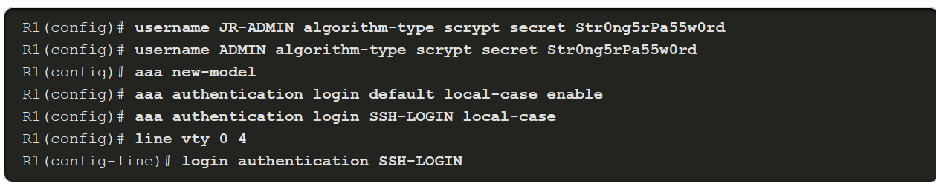
Configure Local AAA Authentication
Default and Named Methods
For flexibility, different method lists can be applied to different interfaces and lines using the aaa authentication login list-name command.
The named list must be explicitly enabled on the line using the login authentication line configuration command. If a line has a custom authentication method list applied to it, that method list overrides the default method list for that interface.
When a custom authentication method list is applied to an interface, it is possible to return to the default method list by using the no authentication login command.
Notes:
7: Authentication, Authorization, and Accounting (AAA) 7.2: Configure Local AAA Authentication 7.2.3: Default and Named Methods

Slide 14
Configure Local AAA Authentication
Fine-Tuning the Authentication Configuration
Additional security can be implemented on the line using the aaa local authentication attempts max-fail global configuration mode command. This command secures AAA user accounts by locking out accounts that have excessive failed attempts.
Command | Description
number-of-unsuccessful-attempts | Number of unsuccessful authentication attempts before a connection is dropped and the user account is locked.
The locked out user account remains locked until it is manually cleared by an administrator using the clear aaa local user lockout privileged EXEC mode command.
To display the attributes that are collected for one AAA session, use the show aaa user command in privileged EXEC mode.
Notes:
7: Authentication, Authorization, and Accounting (AAA) 7.2: Configure Local AAA Authentication 7.2.4: Fine-Tuning the Authentication Configuration

Slide 15
7.3 Server-Based AAA Characteristics and Protocols
Notes:
7: Authentication, Authorization, and Accounting (AAA) 7.3: Server-Based AAA Characteristics and Protocols

Slide 16
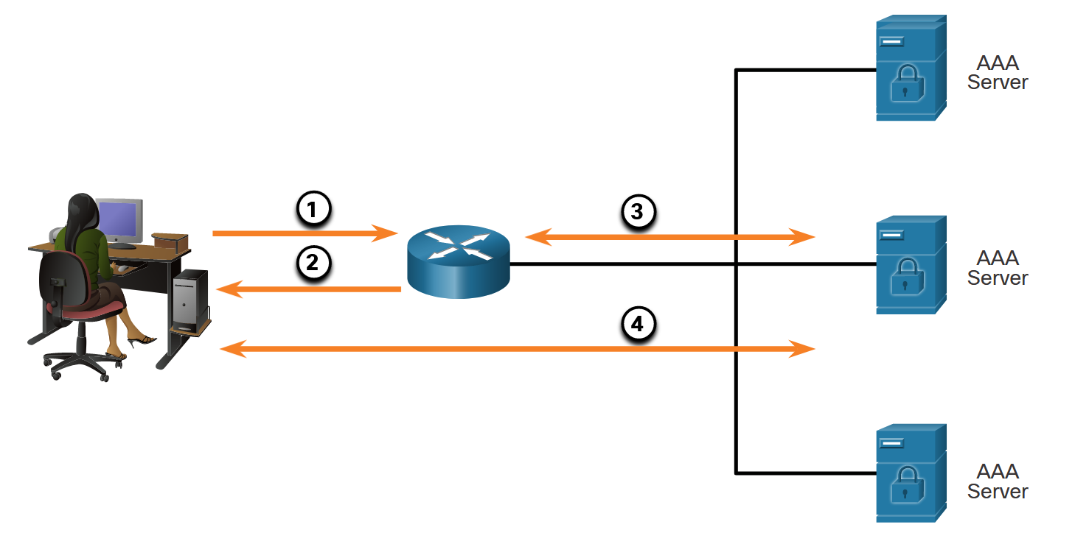
Server-Based AAA Characteristics and Protocols
Compare Local AAA and Server-Based AAA Implementations
One or more AAA servers can be used to manage the user and administrative access needs for an entire corporate network. AAA server software can create a central user and administrative access database to which all devices in the network can refer. It may also work with many external databases, including Active Directory and Lightweight Directory Access Protocol (LDAP). These databases store user account information and passwords, allowing for central administration of user accounts. For increased redundancy, multiple servers can be implemented.
The figure shows the process of authenticating router administrator users.
Notes:
7: Authentication, Authorization, and Accounting (AAA) 7.3: Server-Based AAA Characteristics and Protocols 7.3.1: Compare Local AAA and Server-Based AAA Implementations

Slide 17
Server-Based AAA Characteristics and Protocols
Cisco Identity Services Engine (ISE)
Cisco Identity Services Engine (ISE) is an identity and access control policy platform that enables enterprises to enforce compliance, enhance infrastructure security, and streamline their service operations. Cisco ISE combines policy definition, control, and reporting in one appliance. Cisco ISE defines fair access policies and enforces compliance for all end devices including BYOD.
Several features of ISE are:
Asset Visibility
Posture assessment
Segmentation
Guest management and secure wireless
Threat Containment
Notes:
7: Authentication, Authorization, and Accounting (AAA) 7.3: Server-Based AAA Characteristics and Protocols 7.3.2: Cisco Identity Services Engine (ISE)

Slide 18
Server-Based AAA Characteristics and Protocols
The TACACS+ and RADIUS Protocols
TACACS+ and RADIUS are both authentication protocols that are used to communicate with AAA servers. As shown in the table, each supports different capabilities and functionality.
 | TACACS+ | RADIUS
Functionality | Separates AAA according to the AAA architecture, allowing modularity of the security server implementation | Combines authentication and authorization but separates accounting, allowing less flexibility in implementation than TACACS+
Standard | Mostly Cisco supported | Open/RFC standard
Transport Protocol | TCP/49 | UDP/1645/1646 and 1812/1813
CHAP | Bidirectional challenge and response as used in Challenge Handshake Authentication Protocol (CHAP) | Unidirectional challenge and response from the RADIUS security server to the RADIUS client
Confidentiality | Entire packet encrypted | Password encrypted
Customization | Provides authorization of router commands on a per-user or per-group basis | Has no option to authorize router commands on a per-user or per-group basis
Accounting | Limited | Extensive
Notes:
7: Authentication, Authorization, and Accounting (AAA) 7.3: Server-Based AAA Characteristics and Protocols 7.3.3: The TACACS+ and RADIUS Protocols

Slide 19
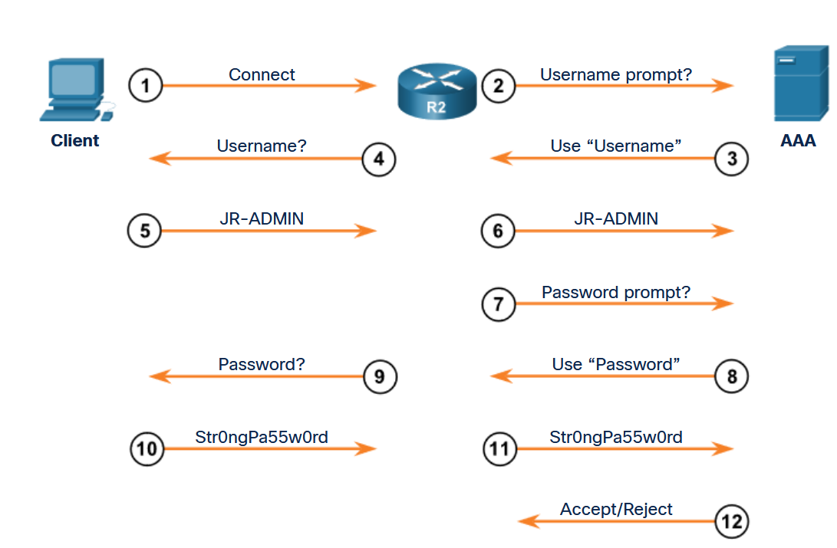
Server-Based AAA Characteristics and Protocols
TACACS+ Authentication
TACACS+ is a Cisco enhancement to the original TACACS protocol.
TACACS+ provides separate AAA services. It is possible to use TACACS+ for authorization and accounting while using another method of authentication.
The TACACS+ authentication process is shown in the figure.
Notes:
7: Authentication, Authorization, and Accounting (AAA) 7.3: Server-Based AAA Characteristics and Protocols 7.3.4: TACACS+ Authentication

Slide 20
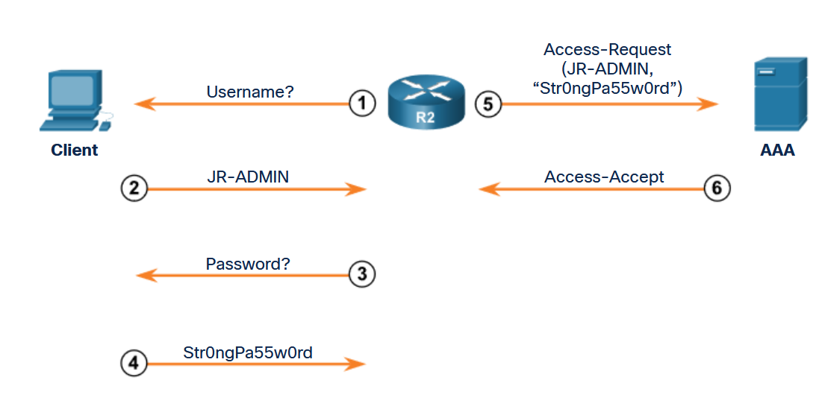
Server-Based AAA Characteristics and Protocols
RADIUS Authentication
RADIUS is an open IETF standard AAA protocol for applications such as network access or IP mobility. RADIUS works in both local and roaming situations and is commonly used for accounting purposes.
The RADIUS protocol hides passwords during transmission, even with the Password Authentication Protocol (PAP), using a rather complex operation that involves Message Digest 5 (MD5) hashing and a shared secret. However, the rest of the packet is sent in plaintext.
RADIUS combines authentication and authorization as one process.
The figure shows the RADIUS authentication process.
Notes:
7: Authentication, Authorization, and Accounting (AAA) 7.3: Server-Based AAA Characteristics and Protocols 7.3.5: RADIUS Authentication
7.3.6: Check Your Understanding - Identify the AAA Communication Protocol

Slide 21
7.4 Configure Server-Based Authentication
Notes:
7: Authentication, Authorization, and Accounting (AAA) 7.4: Configure Server-Based Authentication

Slide 22
Configure Server-Based Authentication
Steps to Configure Server-Based AAA Authentication
There are four basic steps to configure server-based authentication:
Step 1. Globally enable AAA to allow the use of all AAA elements. This step is a prerequisite for all other AAA commands.
Step 2. Specify the server that will provide AAA services for the router. This can be a TACACS+ or RADIUS server.
Step 3. Configure the encryption key needed to encrypt the data transfer between the network device and AAA server.
Step 4. Configure the AAA authentication method list to refer to the TACACS+ or RADIUS server. For redundancy, it is possible to configure more than one server.
Notes:
7: Authentication, Authorization, and Accounting (AAA) 7.4: Configure Server-Based Authentication 7.4.1: Steps to Configure Server-Based AAA Authentication

Slide 23
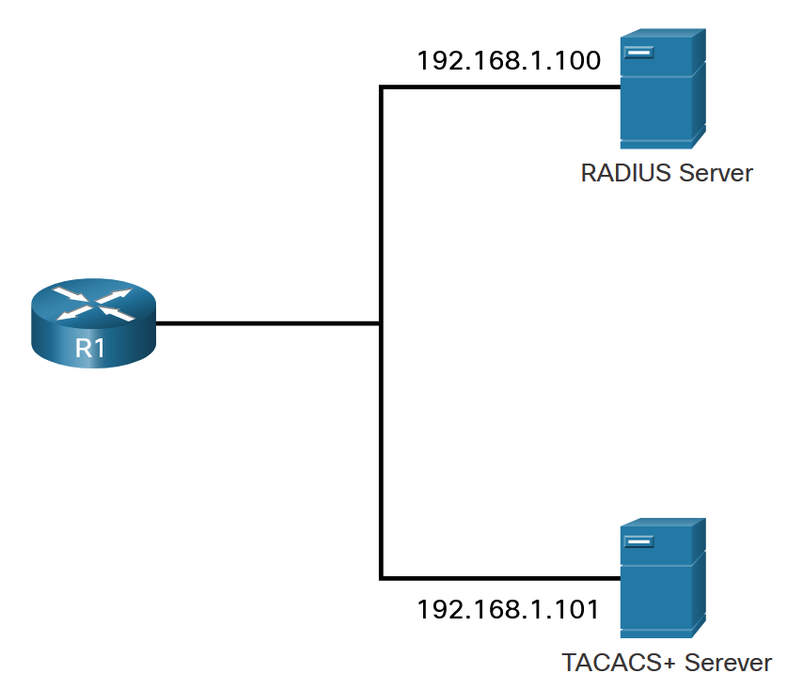
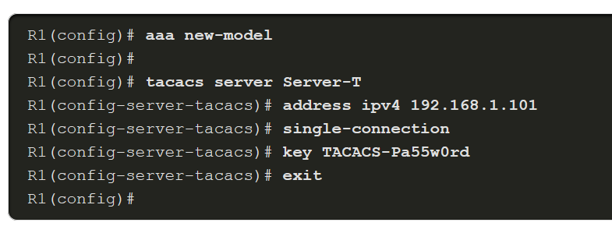
Configure Server-Based Authentication
Configure TACACS+ Servers
To configure a TACACS+ server, globally enable AAA using the aaa new-model command.
Use the tacacs server name command.
In TACACS+ server configuration mode, configure the IPv4 address of the TACACS+ server using the address ipv4 command. The address ipv4 command allows the option to modify the authentication port and the accounting port.
Use the single-connection command to enhance TCP performance. If required, multiple TACACS+ servers can be identified by entering their respective IPv4 addresses using the tacacs server name command.
The key key command is used to configure the shared secret key to encrypt the data transfer between the TACACS+ server and AAA-enabled router.
Notes:
7: Authentication, Authorization, and Accounting (AAA) 7.4: Configure Server-Based Authentication 7.4.2: Configure TACACS+ Servers

Slide 24
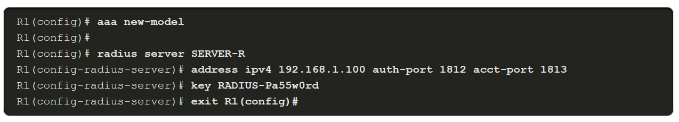
Configure Server-Based Authentication
Configure RADIUS Servers
To configure a RADIUS server, use the radius server name command.
If required, multiple RADIUS servers can be identified by entering a radius server name command for each server.
In RADIUS server configuration mode, configure the IPv4 address of the RADIUS server using the address ipv4 ipv4-address command.
To configure the shared secret key for encrypting the password, use the key command.
RADIUS traffic is using User Datagram Protocol (UDP) ports 1812, 1813 or 1645, and 1646.
Notes:
7: Authentication, Authorization, and Accounting (AAA) 7.4: Configure Server-Based Authentication 7.4.3: Configure RADIUS Servers

Slide 25
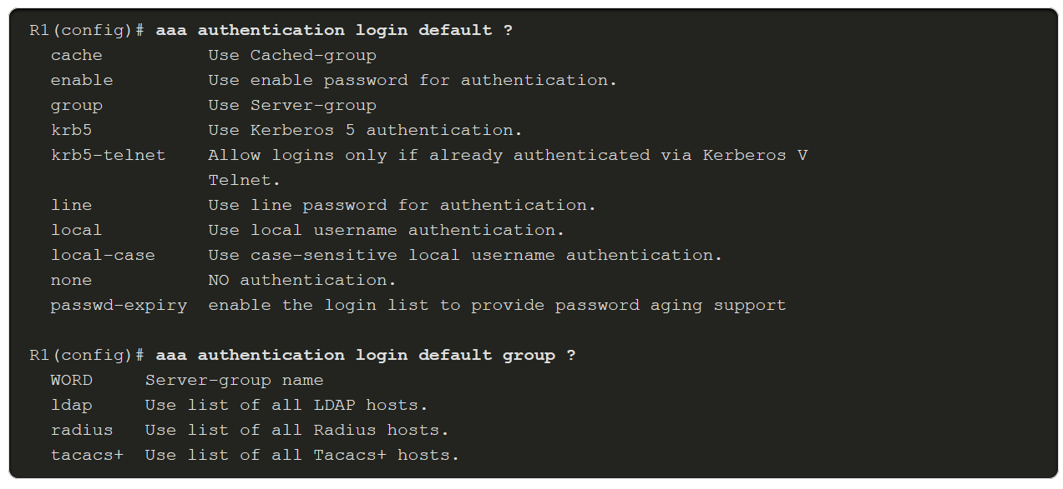
Configure Server-Based Authentication
Authenticate to the AAA Server Configuration Commands
When the AAA security servers have been identified, the servers must be included in the method list of the aaa authentication login command. AAA servers are identified using the group tacacs+ or group radius keywords. Refer to the figure to see command syntax options available with the aaa authentication login command.
Notes:
7: Authentication, Authorization, and Accounting (AAA) 7.4: Configure Server-Based Authentication 7.4.4: Authenticate to the AAA Server Configuration Commands
7.4.5: Syntax Checker - Configure Server-Based AAA Authentication

Slide 26
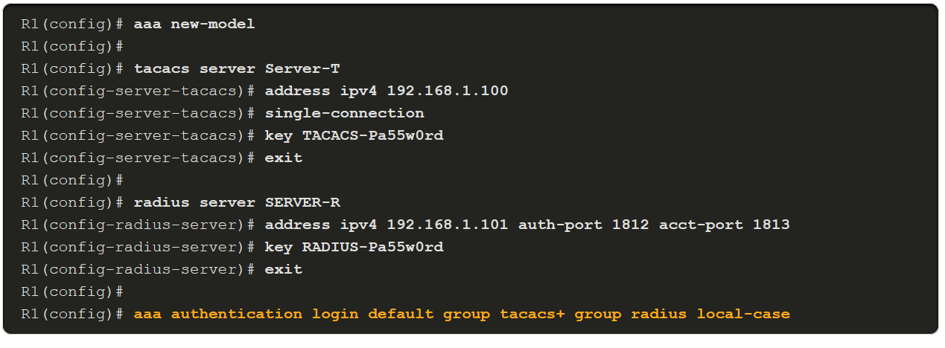
Configure Server-Based Authentication
Authenticate to the AAA Server Configuration Commands (Cont.)
To configure a method list for the default login to authenticate first using a TACACS+ server, second with a RADIUS server, and finally with a local username database, specify the order with the aaa authentication login default command, as highlighted in the example.
Notes:
7: Authentication, Authorization, and Accounting (AAA) 7.4: Configure Server-Based Authentication 7.4.4: Authenticate to the AAA Server Configuration Commands
7.4.5: Syntax Checker - Configure Server-Based AAA Authentication

Slide 27
7.5 Configure Server-Based Authorization and Accounting
Notes:
7: Authentication, Authorization, and Accounting (AAA) 7.5: Configure Server-Based Authorization and Accounting

Slide 28
Configure Server-Based Authorization and Accounting
Introduction to Server-Based AAA Authorization
Authorization is concerned with allowing and disallowing authenticated users access to functions of the network device interface. The TACACS+ protocol allows the separation of authentication from authorization. A router can be configured to restrict the user to performing only certain functions after successful authentication. Keep in mind that RADIUS does not separate the authentication from the authorization process.
Another important aspect of authorization is the ability to control user access to specific services.
By default, TACACS+ establishes a new TCP session for every authorization request, which can lead to delays when users enter commands. To improve performance, AAA supports persistent TCP sessions that are configured with the single-connection tacacs server configuration mode command.
Notes:
7: Authentication, Authorization, and Accounting (AAA) 7.5: Configure Server-Based Authorization and Accounting 7.5.1: Introduction to Server-Based AAA Authorization

Slide 29
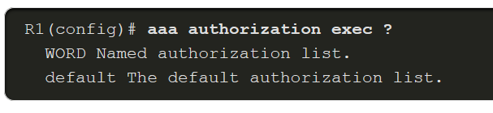
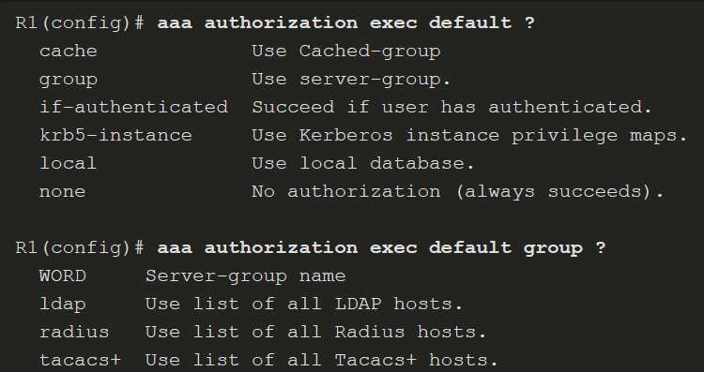
Configure Server-Based Authorization and Accounting
AAA Authorization Configuration
To configure authorization, use the aaa authorization command, as shown in the examples below. The authorization type can specify the types of commands or services:
network - for network services such as PPP and SLIP
exec - for User EXEC terminal sessions
commands level - command authorization attempts authorization for all EXEC mode commands, including global configuration commands, associated with a specific privilege level
Notes:
7: Authentication, Authorization, and Accounting (AAA) 7.5: Configure Server-Based Authorization and Accounting 7.5.2: AAA Authorization Configuration

Slide 30
Configure Server-Based Authorization and Accounting
Introduction to Server-Based AAA Accounting
AAA accounting enables usage tracking.
When accounting is configured on a AAA server it functions as a central repository for accounting information.
Each session that is established through Cisco Secure ACS can be fully accounted for and stored on the server.
Like authentication and authorization method lists, method lists for accounting define the way accounting is performed and the sequence in which these methods are performed. After it is enabled, the default accounting method list is automatically applied to all interfaces, except those that have a user-defined, or custom, accounting method list that has been explicitly defined.
Notes:
7: Authentication, Authorization, and Accounting (AAA) 7.5: Configure Server-Based Authorization and Accounting 7.5.3: Introduction to Server-Based AAA Accounting

Slide 31
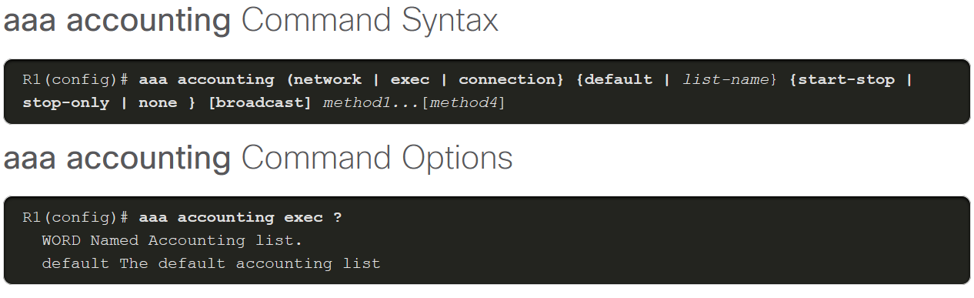
Configure Server-Based Authorization and Accounting
AAA Accounting Configuration
To configure AAA accounting, use the aaa accounting command that is shown in the figure.
The following three parameters are commonly used aaa accounting keywords:
network - Runs accounting for all network-related service requests, including PPP.
exec - Runs accounting for the EXEC shell session.
connection - Runs accounting on all outbound connections such as SSH and Telnet.
Notes:
7: Authentication, Authorization, and Accounting (AAA) 7.5: Configure Server-Based Authorization and Accounting 7.5.4: AAA Accounting Configuration

Slide 32
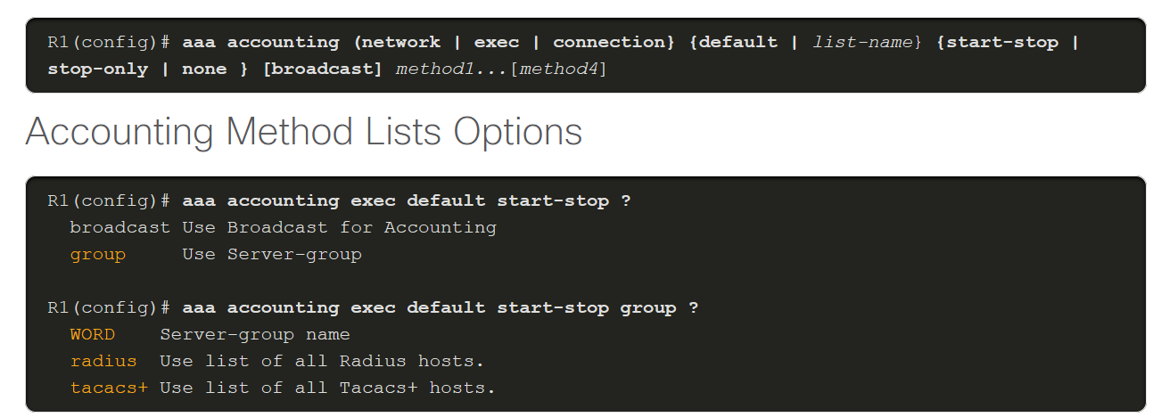
Configure Server-Based Authorization and Accounting
AAA Accounting Configuration (Cont.)
As with AAA authentication, either the keyword default or a list-name can be used. Next, the record type, or trigger, is configured. The trigger specifies what actions cause accounting records to be updated.
Possible triggers include:
start-stop - Sends a "start" accounting notice at the beginning of a process and a "stop" accounting notice at the end of a process.
stop-only - Sends a "stop" accounting record for all cases including authentication failures.
none - Disables accounting services on a line or interface.
The figures show the command syntax and method list options available.
Notes:
7: Authentication, Authorization, and Accounting (AAA) 7.5: Configure Server-Based Authorization and Accounting 7.5.4: AAA Accounting Configuration
7.5.5: Syntax Checker - Configure AAA Accounting

Slide 33
Module 8: Access Control Lists
Networking Security v1.0
(NETSEC)
Notes:
Networking Security (NETSEC) Module 8: Access Control Lists

Slide 34
Module Objectives
Module Title: Access Control Lists
Module Objective: Implement access control lists (ACLs) to filter traffic and mitigate network attacks on a network.
Topic Title | Topic Objective
Introduction to Access Control Lists | Describe standard and extended ACLs.
Wildcard Masks | Explain how ACLs use wildcard masks.
Configure ACLs | Explain how to configure ACLs.
Modify ACLs | Use sequence numbers to edit existing standard IPv4 ACLs.
Implement ACLs | Implement ACLs.
Mitigate Attacks with ACLs | Use ACLs to mitigate common network attacks.
IPv6 ACLs | Configure IPv6 ACLs using CLI.
Notes:
34

Slide 35
8.1 Introduction to Access Control Lists
Notes:
8: Access Control Lists 8.1: Introduction to Access Control Lists

Slide 36
Introduction to Access Control Lists
What is an ACL?
An ACL is a series of IOS commands that are used to filter packets based on information found in the
packet header.
Task | Example
Limit network traffic to increase network performance | A corporate policy prohibits video traffic on the network to reduce the network load. A policy can be enforced using ACLs to block video traffic.
Provide traffic flow control | A corporate policy requires that routing protocol traffic be limited to certain links only. A policy can be implemented using ACLs to restrict the delivery of routing updates to only those that come from a known source.
Provide a basic level of security for network access | Corporate policy demands that access to the Human Resources network be restricted to authorized users only. A policy can be enforced using ACLs to limit access to specified networks.
Filter traffic based on traffic type | Corporate policy requires that email traffic be permitted into a network, but that Telnet access be denied. A policy can be implemented using ACLs to filter traffic by type.
Screen hosts to permit or deny access to network services | Corporate policy requires that access to some file types (e.g., FTP or HTTP) be limited to user groups. A policy can be implemented using ACLs to filter user access to services.
Provide priority to certain classes of network traffic | Corporate traffic specifies that voice traffic be forwarded as fast as possible to avoid any interruption. A policy can be implemented using ACLs and QoS services to identify voice traffic and process it immediately.
Notes:
8: Access Control Lists 8.1: Introduction to Access Control Lists 8.1.1: What is an ACL?

Slide 37
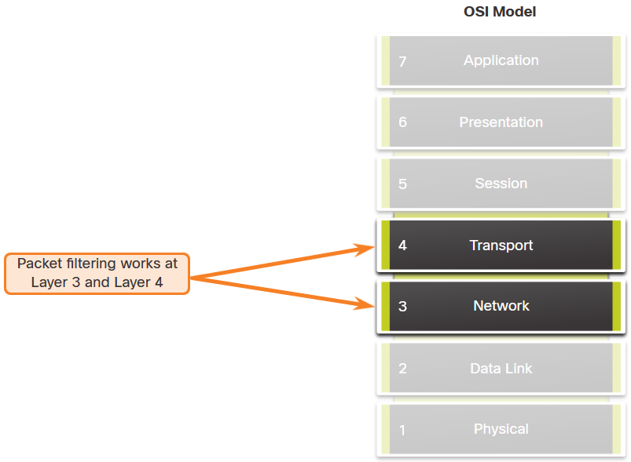
Introduction to Access Control Lists
Packet Filtering
Packet filtering controls access to a network by analyzing the incoming and/or outgoing packets and forwarding them or discarding them based on given criteria. Packet filtering can occur at Layer 3 or Layer 4. Cisco routers support standard and extended ACLs.
Notes:
8: Access Control Lists 8.1: Introduction to Access Control Lists 8.1.2: Packet Filtering

Slide 38
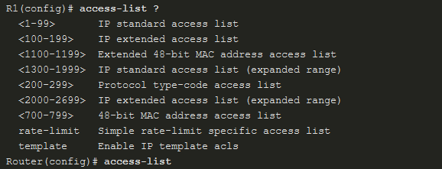

Introduction to Access Control Lists
Numbered and Named ACLs
Numbered ACLs - ACLs number 1 to 99, or 1300 to 1999 are standard ACLs while ACLs number 100 to 199, or 2000 to 2699 are extended ACLs, as shown in the output.
Named ACLs - Named ACLs is the preferred method to use when configuring ACLs. Specifically, standard and extended ACLs can be named to provide information about the purpose of the ACL. The ip access-list global configuration command is used to create a named ACL.
Notes:
8: Access Control Lists 8.1: Introduction to Access Control Lists 8.1.3: Numbered and Named ACLs

Slide 39
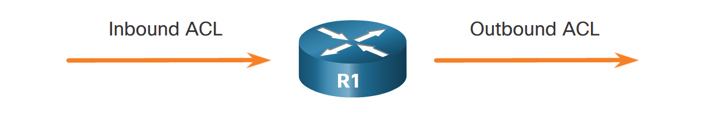
Introduction to Access Control Lists
ACL Operation
ACLs define the set of rules that give added control for packets that enter inbound interfaces, packets that relay through the router, and packets that exit outbound interfaces of the router.
An inbound ACL filters packets before they are routed to the outbound interface. If the packet is permitted by the ACL, it is then processed for routing. Inbound ACLs are best used to filter packets when the network attached to an inbound interface is the only source of packets that need to be examined.
An outbound ACL filters packets after being routed, regardless of the inbound interface. Incoming packets are routed to the outbound interface and then they are processed through the outbound ACL. Outbound ACLs are best used when the same filter will be applied to packets coming from multiple inbound interfaces before exiting the same outbound interface.
Notes:
8: Access Control Lists 8.1: Introduction to Access Control Lists 8.1.4: ACL Operation

Slide 40
8.2 Wildcard Masking
Notes:
8: Access Control Lists 8.2: Wildcard Masking

Slide 41
Wildcard Masking
Wildcard Mask Overview
A wildcard mask is like a subnet mask in that it uses the ANDing process to identify which bits in an IPv4 address to match. However, they differ in the way they match binary 1s and 0s. Unlike a subnet mask, in which binary 1 is equal to a match and binary 0 is not a match, in a wildcard mask, the reverse is true.
Wildcard Mask | Last Octet (in Binary) | Meaning (0 - match, 1 - ignore)
0.0.0.0 | 00000000 | Match all octets.
0.0.0.63 | 00111111 | Match the first three octets Match the two left most bits of the last octet Ignore the last 6 bits
0.0.0.15 | 00001111 | Match the first three octets Match the four left most bits of the last octet Ignore the last 4 bits of the last octet
0.0.0.252 | 11111100 | Match the first three octets Ignore the six left most bits of the last octet Match the last two bits
0.0.0.255 | 11111111 | Match the first three octet Ignore the last octet
Notes:
8: Access Control Lists 8.2: Wildcard Masking 8.2.1: Wildcard Mask Overview

Slide 42
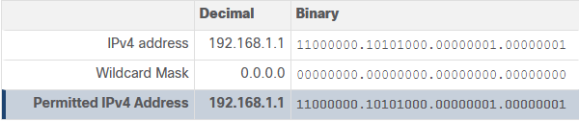
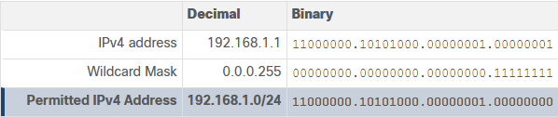
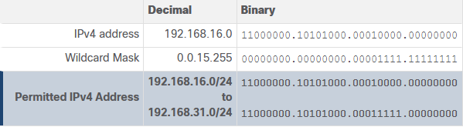
Wildcard Masking
Wildcard Mask Types
Wildcard Mask to Match a Host
Wildcard Mask to Match an IPv4 Subnet
Wildcard Mask to Match an IPv4 Address Range
Notes:
8: Access Control Lists 8.2: Wildcard Masking 8.2.2: Wildcard Mask Types

Slide 43
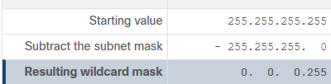
Wildcard Masking
Wildcard Mask Calculation
Calculating wildcard masks can be challenging. One shortcut method is to subtract the subnet mask from 255.255.255.255.
Assume you wanted an ACE in ACL 10 to permit access to all users in the 192.168.3.0/24 network. To calculate the wildcard mask, subtract the subnet mask (i.e., 255.255.255.0) from 255.255.255.255, as shown in the table.
The solution produces the wildcard mask 0.0.0.255. Therefore, the ACE would be access-list 10 permit 192.168.3.0 0.0.0.255.
Notes:
8: Access Control Lists 8.2: Wildcard Masking 8.2.3: Wildcard Mask Calculation

Slide 44

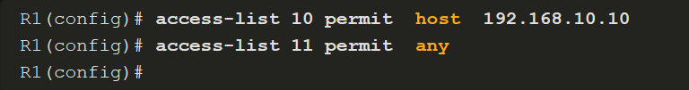
Wildcard Masking
Wildcard Mask Keywords
Keywords reduce ACL keystrokes and make it easier to read the ACE:
host - This keyword substitutes for the 0.0.0.0 mask. This mask states that all IPv4 address bits must match to filter just one host address.
any - This keyword substitutes for the 255.255.255.255 mask. This mask says to ignore the entire IPv4 address or to accept any addresses.
For example, these ACL commands…
…can be rewritten as follows:
Notes:
8: Access Control Lists 8.2: Wildcard Masking 8.2.4: Wildcard Mask Keywords
8.2.5: Check Your Understanding – Wildcard Masks in ACLs

Slide 45
8.3 Configure ACLs
Notes:
8: Access Control Lists 8.3: Configure ACLs

Slide 46
Configure ACLs
Create an ACL
When configuring a complex ACL, it is suggested that you:
Use a text editor and write out the specifics of the policy to be implemented.
Add the IOS configuration commands to accomplish those tasks.
Include remarks to document the ACL.
Copy and paste the commands onto the device.
Always thoroughly test an ACL to ensure that it correctly applies the desired policy.
Notes:
8: Access Control Lists 8.3: Configure ACLs 8.3.1: Create an ACL

Slide 47
Configure ACLs
Numbered Standard IPv4 ACL Syntax
To create a numbered standard ACL, use the following global configuration command:
Use the no access-list access-list-number global configuration command to remove a numbered standard ACL.
Notes:
8: Access Control Lists 8.3: Configure ACLs 8.3.2: Numbered Standard IPv4 ACL Syntax

Slide 48
Configure ACLs
Numbered Standard IPv4 ACL Syntax (Cont.)
This table provides a detailed explanation of the syntax for a standard ACL.
Parameter | Description
access-list-number | This is the decimal number of the ACL. Standard ACL number range is 1 to 99 or 1300 to 1999.
deny | This denies access if the condition is matched.
permit | This permits access if the condition is matched.
remark text | (Optional) This adds a text entry for documentation purposes. Each remark is limited to 100 characters.
source | This identifies the source network or host address to filter. Use the any keyword to specify all networks. Use the host ip-address keyword or simply enter an ip-address (without the host keyword) to identify a specific IP address.
source-wildcard | (Optional) This is a 32-bit wildcard mask that is applied to the . If omitted, a default 0.0.0.0 mask is assumed.
log | (Optional) This keyword generates and sends an informational message whenever the ACE is matched. Message includes ACL number, matched condition (i.e., permitted or denied), source address, and number of packets.{`{" "}`} This message is generated for the first matched packet. This keyword should only be implemented for troubleshooting or security reasons.
Notes:
8: Access Control Lists 8.3: Configure ACLs 8.3.2: Numbered Standard IPv4 ACL Syntax (Cont.)

Slide 49
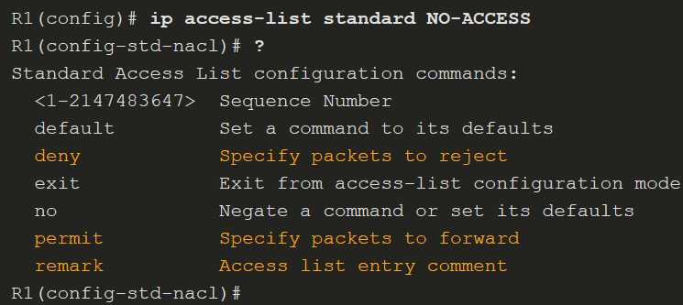
Configure ACLs
Named Standard IPv4 ACL Syntax
ACL names are alphanumeric, case sensitive, and must be unique. Capitalizing ACL names is recommended. To create a named standard ACL, use the following global configuration command:
In the example, a named standard IPv4 ACL called NO-ACCESS is created. Notice that the prompt changes to named standard ACL configuration mode. Use the help facility to view all the named standard ACL ACE options.
Notes:
8: Access Control Lists 8.3: Configure ACLs 8.3.3: Named Standard IPv4 ACL Syntax

Slide 50
Configure ACLs
Numbered Extended IPv4 ACL Syntax
The procedural steps for configuring extended ACLs are the same as for standard ACLs. The extended ACL is first configured, and then it is activated on an interface. However, the command syntax and parameters are more complex to support the additional features provided by extended ACLs.
To create a numbered extended ACL, use the following global configuration command:
The parameters are reviewed on the next two slides.
The command to apply an extended IPv4 ACL to an interface is the same as the command used for standard IPv4 ACLs.
Notes:
8: Access Control Lists 8.3: Configure ACLs 8.3.4: Numbered Extended IPv4 ACL Syntax

Slide 51
Configure ACLs
Numbered Extended IPv4 ACL Syntax (Cont.)
Although there are many keywords and parameters for extended ACLs, it is not necessary to use all of them when configuring an extended ACL. The table provides a detailed explanation of the syntax for an extended ACL.
Parameter | Description
access-list-number | This is the decimal number of the ACL. Extended ACL number range is 100 to 199 and 2000 to 2699.
deny | This denies access if the condition is matched.
permit | This permits access if the condition is matched.
remark text | (Optional) Adds a text entry for documentation purposes. Each remark is limited to 100 characters.
protocol | Name or number of an internet protocol. Common keywords include ip, tcp, udp, and icmp. The ip keyword matches all IP protocols.
source | This identifies the source network or host address to filter. Use the any keyword to specify all networks. Use the host ip-address keyword or simply enter an ip-address (without the host keyword) to identify a specific IP address.
source-wildcard | (Optional) A 32-bit wildcard mask that is applied to the source.
(table continued on next slide)
Notes:
8: Access Control Lists 8.3: Configure ACLs 8.3.4: Numbered Extended IPv4 ACL Syntax (Cont.)

Slide 52
Configure ACLs
Numbered Extended IPv4 ACL Syntax (Cont.)
Parameter | Description
destination | This identifies the destination network or host address to filter. Use the any keyword to specify all networks. Use the host ip-address keyword or ip-address.
destination-wildcard | (Optional) This is a 32-bit wildcard mask that is applied to the destination.
operator | (Optional) This compares source or destination ports. Some operators include lt (less than), gt (greater than), eq (equal), and neq (not equal).
port | (Optional) The decimal number or name of a TCP or UDP port.
established | (Optional) For the TCP protocol only. This is a 1st generation firewall feature.
log | (Optional) This keyword generates and sends an informational message whenever the ACE is matched. This message includes ACL number, matched condition (i.e., permitted or denied), source address, and number of packets. This message is generated for the first matched packet. This keyword should only be implemented for troubleshooting or security reasons.
Notes:
8: Access Control Lists 8.3: Configure ACLs 8.3.4: Numbered Extended IPv4 ACL Syntax (Cont.)

Slide 53
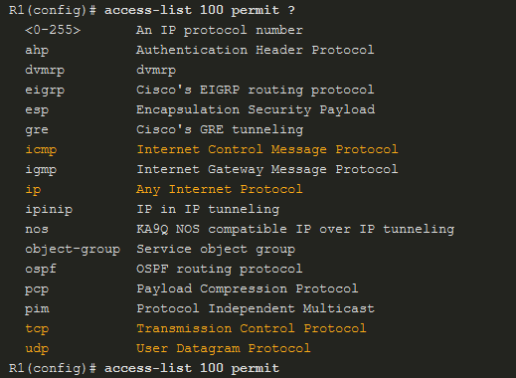
Configure ACLs
Protocols and Port Numbers
Protocol Options - The four highlighted protocols are the most popular options. Use the ? to get help when entering a complex ACE. If an internet protocol is not listed, then the IP protocol number could be specified. For instance, the ICMP protocol number 1, TCP is 6, and UDP is 17.
Notes:
8: Access Control Lists 8.3: Configure ACLs 8.3.5: Protocols and Port Numbers

Slide 54
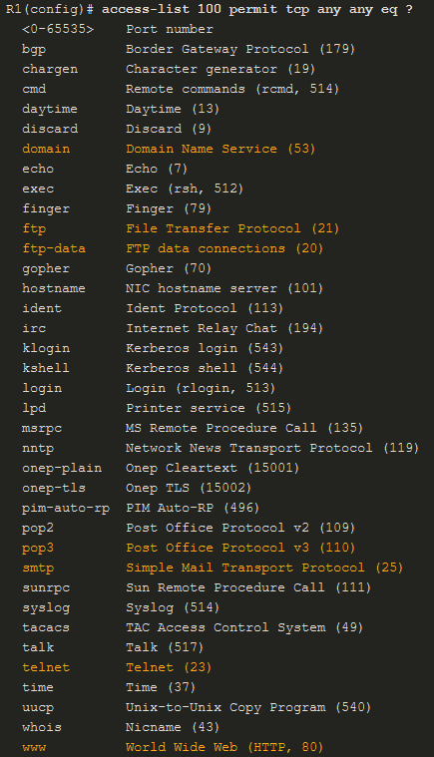
Configure ACLs
Protocols and Port Numbers (Cont.)
Port Keyword Options - Selecting a protocol influences port options. For instance, selecting the:
tcp protocol would provide TCP related ports options
udp protocol would provide UDP specific ports options
icmp protocol would provide ICMP related ports (i.e., message) options
Notice how many TCP port options are available. The highlighted ports are popular options. Port names or number can be specified. However, port names make it easier to understand the purpose of an ACE. Notice how some common ports names (e.g., SSH and HTTPS) are not listed. For these protocols, port numbers will have to be specified.
Notes:
8: Access Control Lists 8.3: Configure ACLs 8.3.5: Protocols and Port Numbers (Cont.)

Slide 55
Configure ACLs
Protocols and Port Numbers Configuration Examples
Extended ACLs can filter on different port number and port name options. This example configures an extended ACL 100 to filter HTTP traffic. The first ACE uses the www port name. The second ACE uses the port number 80. Both ACEs achieve exactly the same result.
Configuring the port number is required when there is not a specific protocol name listed such as SSH (port number 22) or an HTTPS (port number 443)
Notes:
8: Access Control Lists 8.3: Configure ACLs 8.3.6: Protocols and Port Numbers Configuration Examples

Slide 56
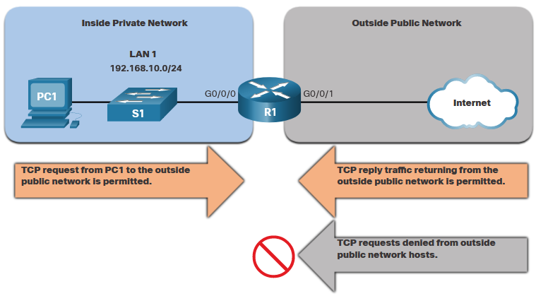
Configure ACLs
TCP Established Extended ACL
TCP can also perform basic stateful firewall services using the TCP established keyword. The keyword enables inside traffic to exit the inside private network and permits the returning reply traffic to enter the inside private network. However, TCP traffic generated by an outside host and attempting to communicate with an inside host is denied. The established keyword can be used to permit only the return HTTP traffic from requested websites, while denying all other traffic.
Notes:
8: Access Control Lists 8.3: Configure ACLs 8.3.7: TCP Established Extended ACL

Slide 57
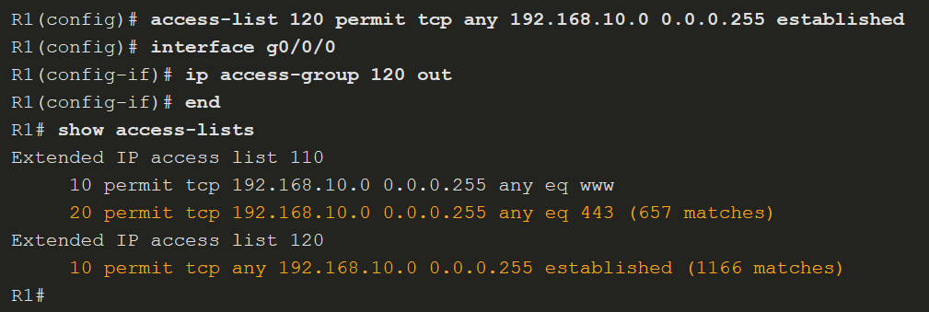
Configure ACLs
TCP Established Extended ACL (Cont.)
In this example, ACL 120 is configured to only permit returning web traffic to the inside hosts. The new ACL is then applied outbound on the R1 G0/0/0 interface. The show access-lists command displays both ACLs. Notice from the match statistics that inside hosts have been accessing the secure web resources from the internet.
Notes:
8: Access Control Lists 8.3: Configure ACLs 8.3.7: TCP Established Extended ACL

Slide 58
Configure ACLs
Named Extended IPv4 ACL Syntax
Naming an ACL makes it easier to understand its function. This command enters the named extended configuration mode. Recall that ACL names are alphanumeric, case sensitive, and must be unique. To create a named extended ACL, use the following global configuration command:
In the example, a named extended ACL called NO-FTP-ACCESS is created and the prompt changed to named extended ACL configuration mode. ACE statements are entered in the named extended ACL sub configuration mode.
Notes:
8: Access Control Lists 8.3: Configure ACLs 8.3.8: Named Extended IPv4 ACL Syntax

Slide 59
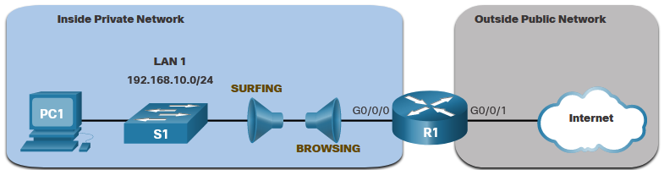
Configure ACLs
Named Extended IPv4 ACL Example
Named extended ACLs are created in essentially the same way that named standard ACLs are created. The topology in the figure is used to demonstrate configuring and applying two named extended IPv4 ACLs to an interface:
SURFING - This will permit inside HTTP and HTTPS traffic to exit to the internet.
BROWSING - This will only permit returning web traffic to the inside hosts while all other traffic exiting the R1 G0/0/0 interface is implicitly denied.
Notes:
8: Access Control Lists 8.3: Configure ACLs 8.3.9: Named Extended IPv4 ACL Example

Slide 60
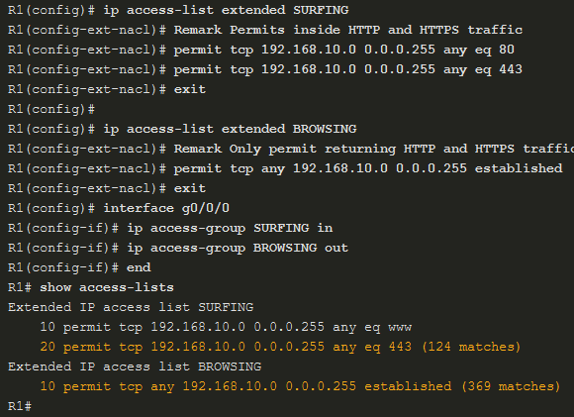
Configure ACLs
Named Extended IPv4 ACL Example (Cont.)
The SURFING ACL permits HTTP and HTTPS traffic from inside users to exit the G0/0/1 interface connected to the internet. Web traffic returning from the internet is permitted back into the inside private network by the BROWSING ACL.
The SURFING ACL is applied inbound and the BROWSING ACL applied outbound on the R1 G0/0/0 interface.
Inside hosts have been accessing the secure web resources from the internet. The show access-lists command is used to verify the ACL statistics.
Notes:
8: Access Control Lists 8.3: Configure ACLs 8.3.9: Named Extended IPv4 ACL Example (Cont.)

Slide 61
Configure ACLs
Time-based ACLs
Works with IP and IPX Extended Access Lists
Time Range Commands
Absolute
absolute [start time date] [end time date]
absolute start 8:00 1 January 1999 end 18:00 31 December 2001
Periodic
periodic days-of-the-week hh:mm to [days-of-the-week] hh:mm
This argument can be any single day or combinations of days: Monday, Tuesday, Wednesday, Thursday, Friday, Saturday, Sunday. Other possible values are:
daily -- Monday through Sunday
weekdays -- Monday through Friday
weekend -- Saturday and Sunday
periodic weekdays 8:00 to 18:00
Overiť na fyzických smerovačoch...

Slide 62
Configure ACLs
Time based ACL
Overiť na fyzických smerovačoch...
R1(config)# time-range WORK_HOURS R1(config-time-range)# periodic weekdays 09:00 to 17:00
R1(config)# ip access-list extended BLOCK_HTTP R1(config-ext-nacl)# deny tcp any any eq 80 time-range WORK_HOURS R1(config-ext-nacl)# permit ip any any
R1(config)# interface FastEthernet 0/0 R1(config-if)# ip access-group BLOCK_HTTP in

Slide 63
8.4 Modify ACLs
Notes:
8: Access Control Lists 8.4: Modify ACLs

Slide 64
Modify ACLs
Two Methods to Modify an ACL
After an ACL is configured, it may need to be modified. ACLs with multiple ACEs can be complex to configure. Sometimes the configured ACE does not yield the expected behaviors. For these reasons, ACLs may initially require a bit of trial and error to achieve the desired filtering result. There are two methods to use when modifying an ACL:
Use a Text Editor
Use Sequence Numbers
Notes:
8: Access Control Lists 8.4: Modify ACLs 8.4.1: Two Methods to Modify an ACL

Slide 65
Modify ACLs
Text Editor Method
ACLs with multiple ACEs should be created in a text editor. This allows you to plan the required ACEs, create the ACL, and then paste it into the router interface. It also simplifies the tasks to edit and fix an ACL. To modify an ACL using a text editor:
Copy the ACL from the running configuration and paste it into the text editor.
Make the necessary edits changes.
Remove the previously configured ACL on the router otherwise, pasting the edited ACL commands will only append (i.e., add) to the existing ACL ACEs on the router.
Copy and paste the edited ACL back to the router.
Notes:
8: Access Control Lists 8.4: Modify ACLs 8.4.2: Text Editor Method

Slide 66
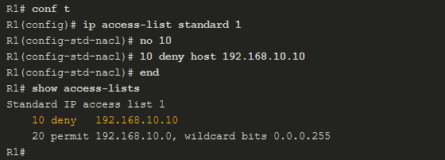
Modify ACLs
Sequence Number Method
An ACL ACE can also be deleted or added using the ACL sequence numbers. Sequence numbers are automatically assigned when an ACE is entered. These numbers are listed in the show access-lists command. The show running-config command does not display sequence numbers.
Use the ip access-list standard command to edit an ACL. Statements cannot be overwritten using the same sequence number as an existing statement. Therefore, the current statement must be deleted first with the no 10 command. Then the correct ACE can be added using sequence number 10 as configured. Verify the changes using the show access-lists command.
ip access-list resequence MENO 10 10
Notes:
8: Access Control Lists 8.4: Modify ACLs 8.4.3: Sequence Number Method
8.4.4: Syntax Checker - Modify IPv4 ACLs

Slide 67
8.5 Implement ACLs
Notes:
8: Access Control Lists 8.5: Implement ACLs

Slide 68
Implement ACLs
ACL Configuration Guidelines
An ACL is made up of one or more access control entries (ACEs) or statements. When configuring and applying an ACL, be aware of the guidelines summarized in this list:
Create an ACL globally and then apply it.
Ensure the last statement is an implicit deny any or deny ip any any.
Remember that statement order is important because ACLs are processed top-down.
As soon as a statement is matched the ACL is exited.
Ensure that the most specific statements are at the top of the list.
Remember that only one ACL is allowed per interface, per protocol, per direction.
Remember that new statements for an existing ACL are added to the bottom of the ACL by default.
Remember that router-generated packets are not filtered by outbound ACLs.
Place standard ACLs as close to the destination as possible.
Place extended ACLs as close to the source as possible.
Notes:
8: Access Control Lists 8.5: Implement ACLs 8.5.1: ACL Configuration Guidelines

Slide 69
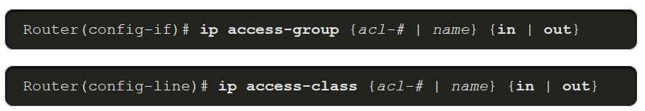
Implement ACLs
Apply an ACL
After creating an ACL, the administrator can apply it in a number of different ways. The following shows the command syntax to apply an ACL to an interface or to the vty lines.
Notes:
8: Access Control Lists 8.5: Implement ACLs 8.5.2: Apply an ACL

Slide 70
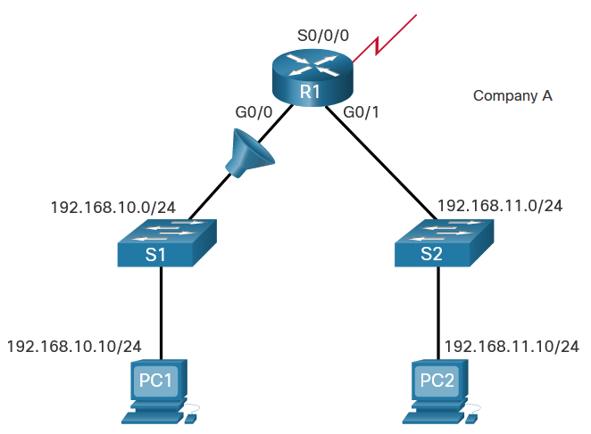
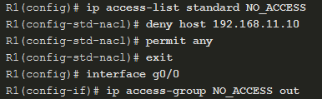
Implement ACLs
Apply an ACL (Cont.)
The figure below shows a named standard ACL applied to outbound traffic.
Notes:
8: Access Control Lists 8.5: Implement ACLs 8.5.2: Apply an ACL (Cont.)

Slide 71
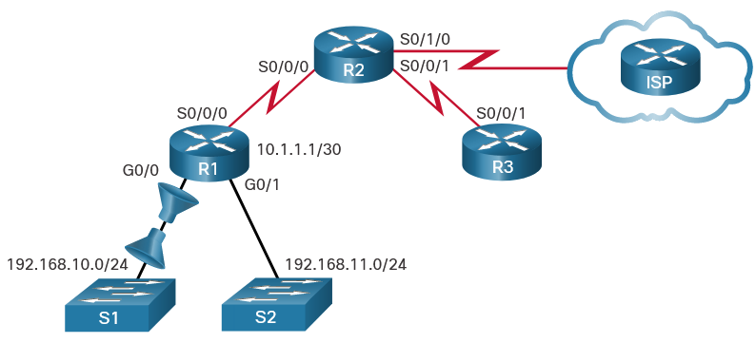
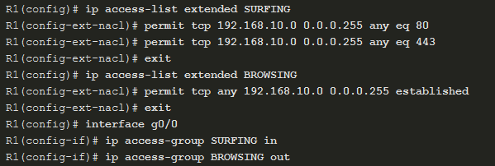
Implement ACLs
Apply an ACL (Cont.)
This figure shows two named extended ACLs. The SURFING ACL is applied to inbound traffic and the BROWSING ACL is applied to outbound traffic.
Notes:
8: Access Control Lists 8.5: Implement ACLs 8.5.2: Apply an ACL (Cont.)

Slide 72
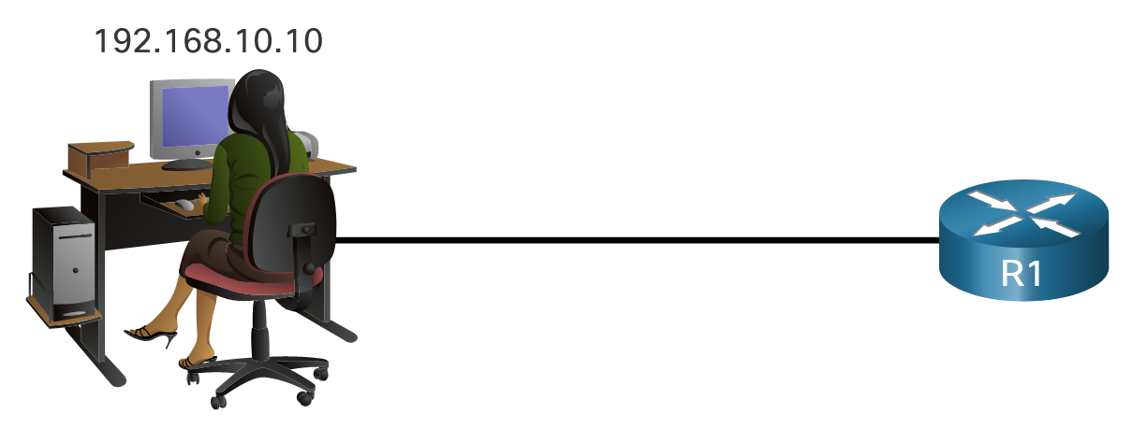
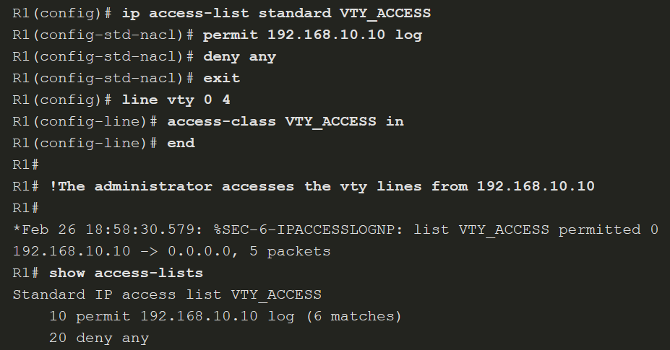
Implement ACLs
Apply an ACL (Cont.)
This example shows an ACL applied to the vty lines.
Notes:
8: Access Control Lists 8.5: Implement ACLs 8.5.2: Apply an ACL (Cont.)

Slide 73
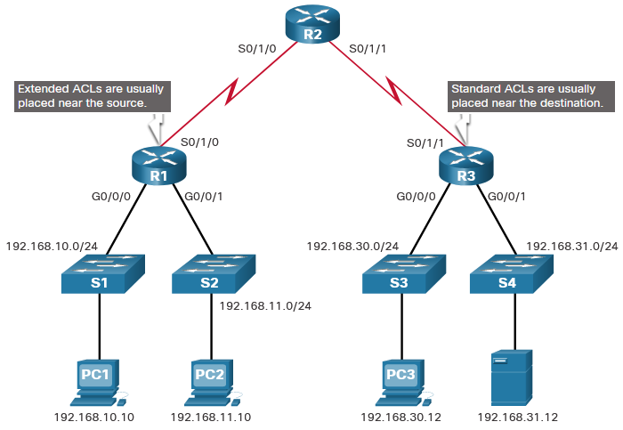
Implement ACLs
Where to Place ACLs
Every ACL should be placed where it is the most efficient.
The figure illustrates where standard and extended ACLs should be located in an enterprise network. Assume the objective is to prevent traffic that originates in the 192.168.10.0/24 network from reaching the 192.168.30.0/24 network.
Notes:
8: Access Control Lists 8.5: Implement ACLs 8.5.3: Where to Place ACLs

Slide 74
Implement ACLs
Where to Place ACLs (Cont.)
Placement of the ACL and therefore, the type of ACL used, may also depend on a variety of factors as listed in the table.
Factors Influencing ACL Placement | Explanation
The extent of organizational control | Placement of the ACL can depend on whether or not the organization has control of both the source and destination networks.
Bandwidth of the networks involved | It may be desirable to filter unwanted traffic at the source to prevent transmission of bandwidth-consuming traffic.
Ease of configuration | It may be easier to implement an ACL at the destination, but traffic will use bandwidth unnecessarily. An extended ACL could be used on each router where the traffic originated. This would save bandwidth by filtering the traffic at the source, but it would require creating extended ACLs on multiple routers.
Notes:
8: Access Control Lists 8.5: Implement ACLs 8.5.3: Where to Place ACLs (Cont.)

Slide 75
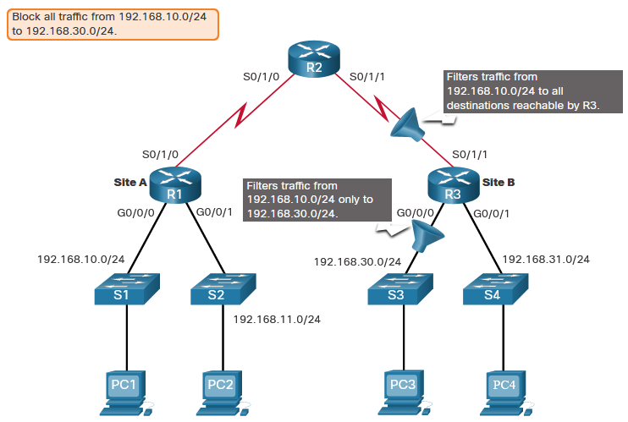
Implement ACLs
Standard ACL Placement Example
Following the guidelines for ACL placement, standard ACLs should be located as close to the destination as possible. In the figure, the administrator wants to prevent traffic originating in the 192.168.10.0/24 network from reaching the 192.168.30.0/24 network.
Notes:
8: Access Control Lists 8.5: Implement ACLs 8.5.4: Standard ACL Placement Example

Slide 76
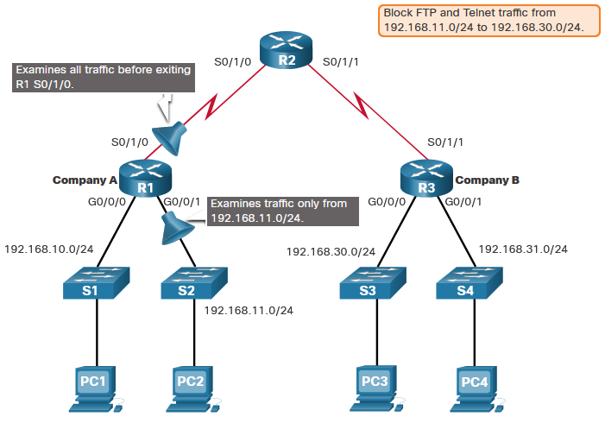
Implement ACLs
Extended ACL Placement Example
Extended ACLs should be located as close to the source as possible. This prevents unwanted traffic from being sent across multiple networks only to be denied when it reaches its destination. However, the organization can only place ACLs on devices that they control. Therefore, the extended ACL placement must be determined in the context of where organizational control extends.
Company A wants to deny Telnet and FTP traffic to Company B’s 192.168.30.0/24 network from their 192.168.11.0/24 network while permitting all other traffic.
Notes:
8: Access Control Lists 8.5: Implement ACLs 8.5.7: Extended ACL Placement Example
8.5.8: Check Your Understanding - Guidelines for ACL Placement
8.5.9: Check Your Understanding- Configuring Standard ACLs
8.5.10: Check Your Understanding- Creating an Extended ACL Statement
8.5.11: Check Your Understanding- Evaluating Extended ACLs

Slide 77
8.6 Mitigate Attacks with ACLs
Notes:
8: Access Control Lists 8.6: Mitigate Attacks with ACLs

Slide 78
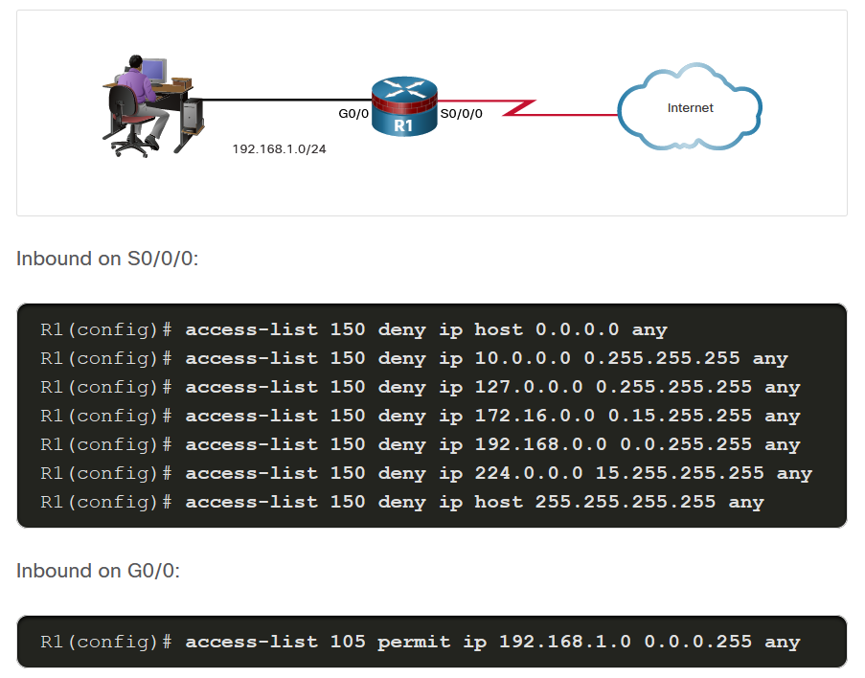
Mitigate Attacks with ACLs
Mitigate Spoofing Attacks
IP address spoofing overrides the normal packet creation process by inserting a custom IP header with a different source IP address. There are many well-known classes of IP addresses that should never be source IP addresses for traffic entering an organization’s network. The S0/0/0 interface is attached to the internet and should never accept inbound packets from the following addresses:
All zeros addresses
Broadcast addresses
Local host addresses (127.0.0.0/8)
Automatic Private IP Addressing (APIPA) addresses (169.254.0.0/16)
Reserved private addresses (RFC 1918)
IP multicast address range (224.0.0.0/4)
Notes:
8: Access Control Lists 8.6: Mitigate Attacks with ACLs 8.6.1: Mitigate Spoofing Attacks

Slide 79
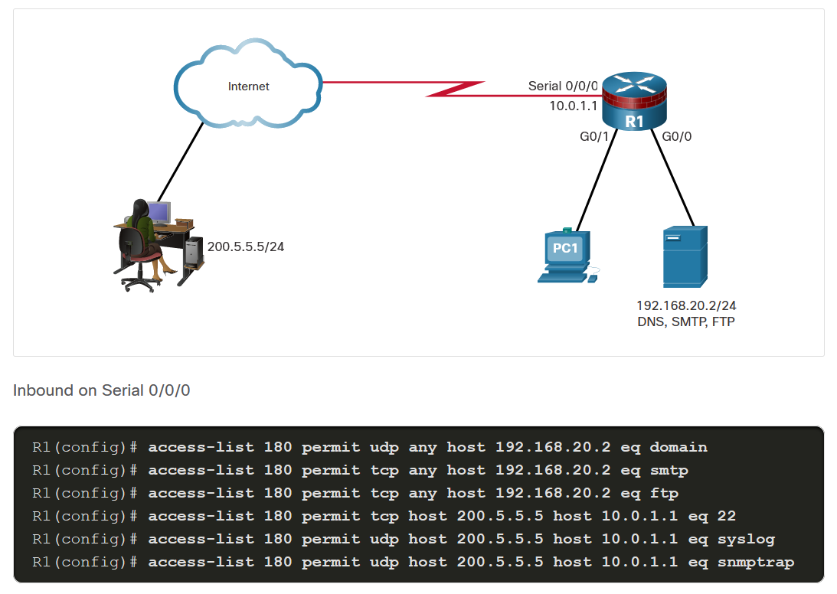
Mitigate Attacks with ACLs
Permit Necessary Traffic through a Firewall
An effective strategy for mitigating attacks is to explicitly permit only certain types of traffic through a firewall. For example, Domain Name System (DNS), Simple Mail Transfer Protocol (SMTP), and File Transfer Protocol (FTP) are services that often must be allowed through a firewall. Secure Shell (SSH), syslog, and Simple Network Management Protocol (SNMP) are examples of services that a router may need to include. The figure shows an example topology with ACL configurations to permit specific services on the Serial 0/0/0 interface.
Notes:
8: Access Control Lists 8.6: Mitigate Attacks with ACLs 8.6.2: Permit Necessary Traffic through a Firewall

Slide 80
Mitigate Attacks with ACLs
Mitigate ICMP Attacks
Both ICMP echo and redirect messages should be blocked inbound by the router. Several ICMP messages are recommended for proper network operation and should be allowed into the internal network:
Echo reply - Allows users to ping external hosts.
Source quench - Requests that the sender decrease the traffic rate of messages.
Unreachable - Generated for packets that are administratively denied by an ACL.
Several ICMP messages are required for proper network operation and should be allowed to exit the network:
Echo - Allows users to ping external hosts.
Parameter problem - Informs the host of packet header problems.
Packet too big - Enables packet maximum transmission unit (MTU) discovery.
Source quench - Throttles down traffic when necessary.
As a rule, block all other ICMP message types outbound.
Notes:
8: Access Control Lists 8.6: Mitigate Attacks with ACLs 8.6.3: Mitigate ICMP Attacks

Slide 81
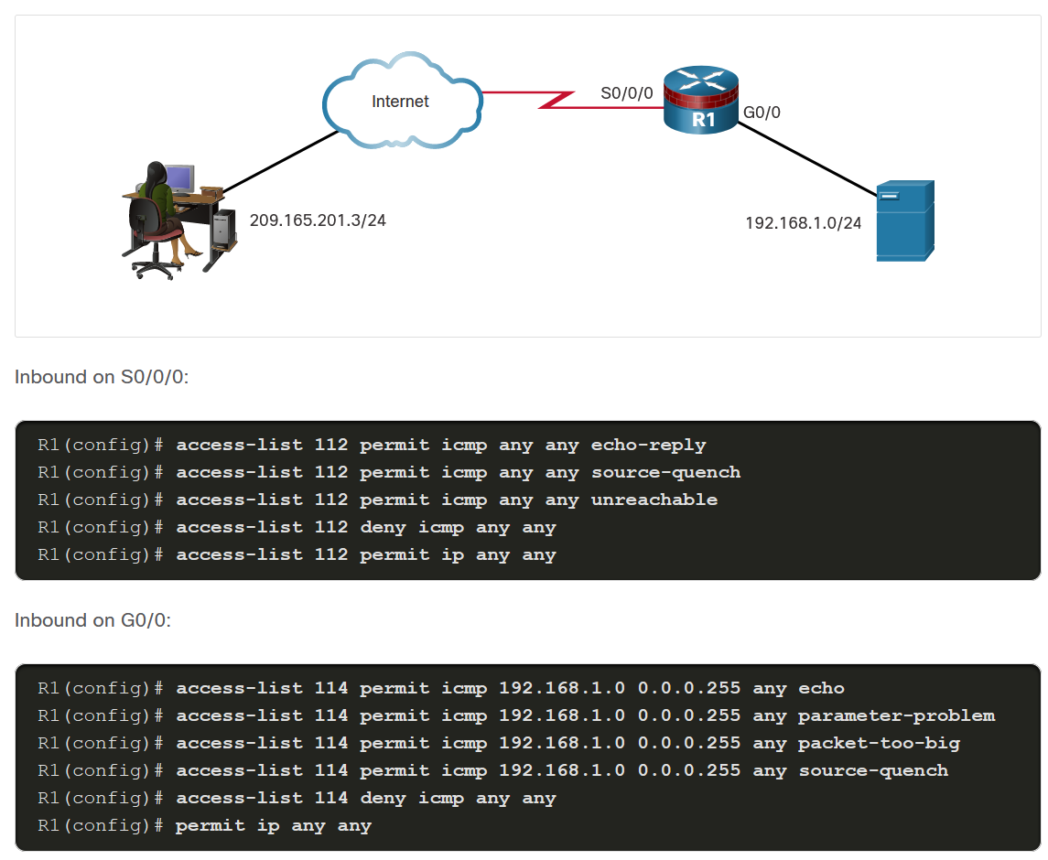
Mitigate Attacks with ACLs
Mitigate ICMP Attacks (Cont.)
The example shows a sample topology and possible ACL configurations to permit specific ICMP services on the G0/0 and S0/0/0 interfaces.
Notes:
8: Access Control Lists 8.6: Mitigate Attacks with ACLs 8.6.3: Mitigate ICMP Attacks

Slide 82
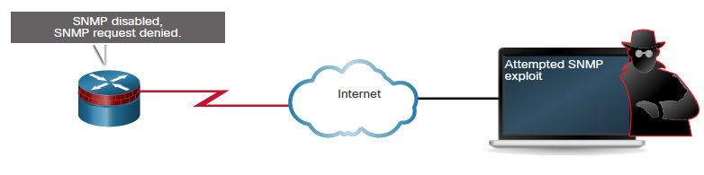
Mitigate Attacks with ACLs
Mitigate SNMP Attacks
Exploitation of SNMP vulnerabilities can be mitigated by applying interface ACLs to filter SNMP packets from non-authorized systems. These security measures are helpful, but the most effective means of exploitation prevention is to disable the SNMP server on IOS devices for which it is not required. Use the command no snmp-server to disable SNMP services on Cisco IOS devices.
Notes:
8: Access Control Lists 8.6: Mitigate Attacks with ACLs 8.6.4: Mitigate SNMP Attacks

Slide 83
8.7 IPv6 ACLs
Notes:
8: Access Control Lists 8.7: IPv6 ACLs

Slide 84
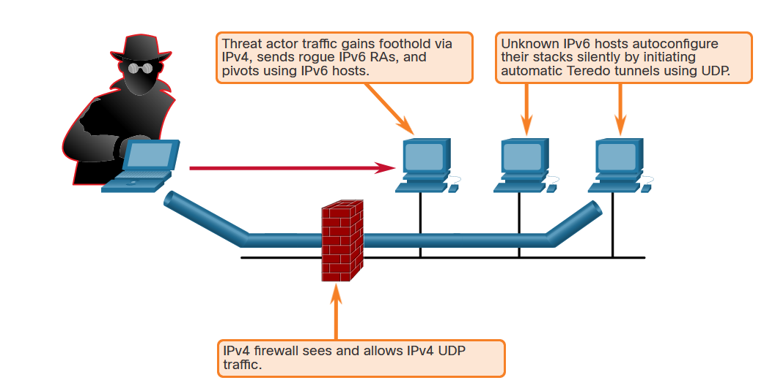
IPv6 ACLs
IPv6 ACL Overview
As the migration to IPv6 continues, IPv6 attacks are becoming more pervasive. IPv4 will not disappear overnight. IPv4 will coexist with IPv6 and then gradually be replaced by IPv6. This creates potential security holes. An example of a security concern is attackers leveraging IPv4 to exploit IPv6 in dual stack environments.
As shown in the figure, threat actors can accomplish stealth attacks that result in trust exploitation by using dual-stacked hosts, rogue Neighbor Discovery Protocol (NDP) messages, and tunneling techniques. To protect against these threats, filter at the edge using various techniques, such as IPv6 ACLs.
Notes:
8: Access Control Lists 8.7: IPv6 ACLs 8.7.1: IPv6 ACL Overview

Slide 85
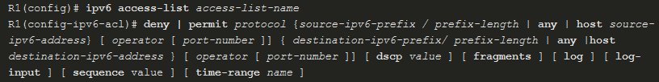
IPv6 ACLs
IPv6 ACL Syntax
The ACL functionality in IPv6 is like ACLs in IPv4. However, there is no equivalent to IPv4 standard ACLs. All IPv6 ACLs must be configured with a name. IPv6 ACLs allow filtering based on source and destination addresses that are traveling inbound and outbound to a specific interface. They also support traffic filtering based on IPv6 option headers and optional, upper-layer protocol type information for finer granularity of control, like extended ACLs in IPv4.
To configure an IPv6 ACL, use the ipv6 access-list command to enter into IPv6 ACL configuration mode. Next, use the syntax shown in the figure to configure each access list entry to specifically permit or deny traffic. Apply an IPv6 ACL to an interface with the ipv6 traffic-filter command.
Notes:
8: Access Control Lists 8.7: IPv6 ACLs 8.7.2: IPv6 ACL Syntax

Slide 86
IPv6 ACLs
IPv6 ACL Syntax (Cont.)
Parameter | Description
deny | permit | Specifies whether to deny or permit the packet.
protocol | Enter the name or number of an Internet protocol, or an integer representing an IPv6 protocol number.
source-ipv6-prefix/prefix-length destination-ipv6-address/prefix-length | The source or destination IPv6 network or class of networks for which to set deny or permit conditions.
any | Enter any as an abbreviation for the IPv6 prefix ::/0. This matches all addresses.
host | For host source-ipv6-address or destination-ipv6-address , enter the source or destination IPv6 host address for which to set deny or permit conditions.
operator | (Optional) An operand that compares the source or destination ports of the specified protocol. Operands are lt (less than), gt (greater than), eq (equal), neq (not equal), and range.
port-number | (Optional) A decimal number or the name of a TCP or UDP port for filtering TCP or UDP, respectively.
(table continued on next slide)
Notes:
8: Access Control Lists 8.7: IPv6 ACLs 8.7.2: IPv6 ACL Syntax (Cont.)

Slide 87
IPv6 ACLs
IPv6 ACL Syntax (Cont.)
Parameter | Description
dscp | (Optional) Matches a differentiated services codepoint value against the traffic class value in the Traffic Class field of each IPv6 packet header. The acceptable range is from 0 to 63.
fragments | (Optional) Matches non-initial fragmented packets where the fragment extension header contains a non-zero fragment offset. The fragments keyword is an option only if the operator [port-number ] arguments are not specified. When this keyword is used, it also matches when the first fragment does not have Layer 4 information.
log | (Optional) Causes an informational logging message about the packet that matches the entry to be sent to the console. (The level of messages logged to the console is controlled by the logging console command.)
log input | (Optional) Provides the same function as the log keyword, except that the logging message also includes the input interface.
sequence value | (Optional) Specifies the sequence number value for the access list statement. The acceptable range is from 1 to 4294967295.
time-range name | (Optional) Specifies the time range that applies to the permit statement. The name of the time range and its restrictions are specified by the time-range and absolute or periodic commands, respectively.
Notes:
8: Access Control Lists 8.7: IPv6 ACLs 8.7.2: IPv6 ACL Syntax (Cont.)

Slide 88
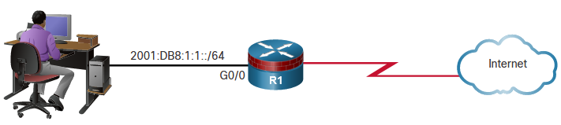

IPv6 ACLs
Configure IPv6 ACLs
An IPv6 ACL contains an implicit deny ipv6 any command. Each IPv6 ACL also contains implicit permit rules to enable IPv6 neighbor discovery. The IPv6 NDP requires the IPv6 network layer to send neighbor advertisements (NAs) and neighbor solicitations (NSs). If an administrator configures the deny ipv6 any command without explicitly permitting neighbor discovery, then the NDP will be disabled.
R1 is permitting inbound traffic on G0/0 from the 2001:DB8:1:1::/64 network. NA and NS packets are explicitly permitted. Traffic sourced from any other IPv6 address is explicitly denied. If the administrator only configured the first permit statement, the ACL would have the same effect. However, it is a good practice to document the implicit statements by explicitly configuring them.
Notes:
8: Access Control Lists 8.7: IPv6 ACLs 8.7.3: Configure IPv6 ACLs

